Slide 1
Report Trial NMS Monitoring PJU

Slide 2

Web Address LMS

Slide 3
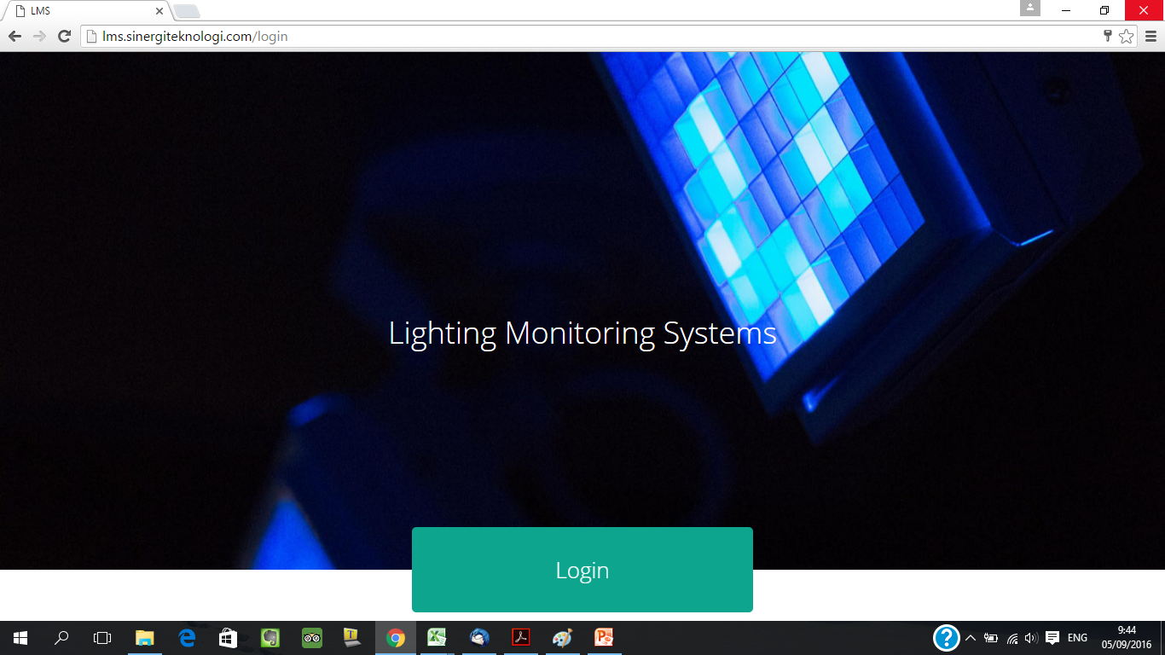
Landing Page LMS

Slide 4
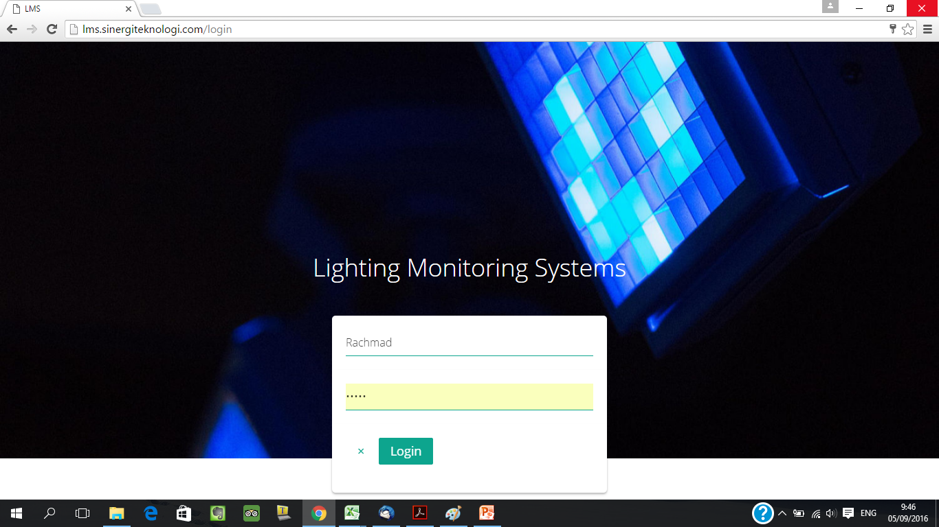
Login
- Username : Rachmad
- Password : Rachmad2016

Slide 5
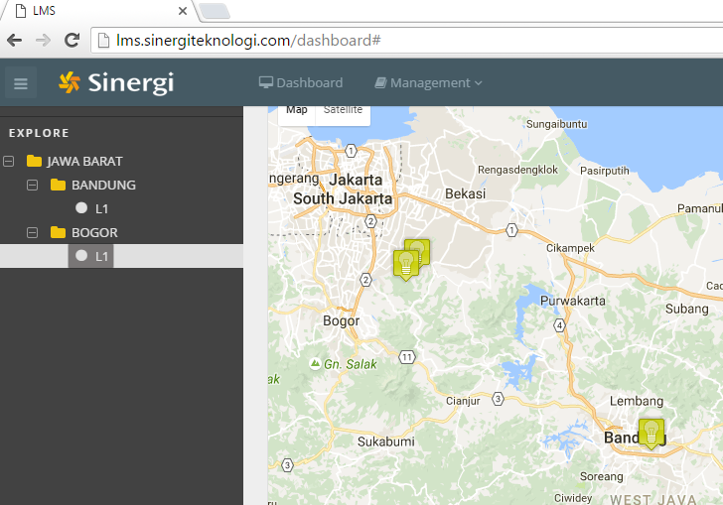
Dashboard LMS

Slide 6
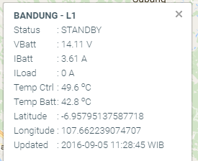
Feature
Pembacaan data
Komunikasi PJU Client – Konsentartor – NMS
View Status PJU
View Status Semua PJU dalam Cluster
View Chart Datalog setiap PJU
View Tabel Datalog setiap PJU
Export Datalog setiap PJU ke excel file

Slide 7
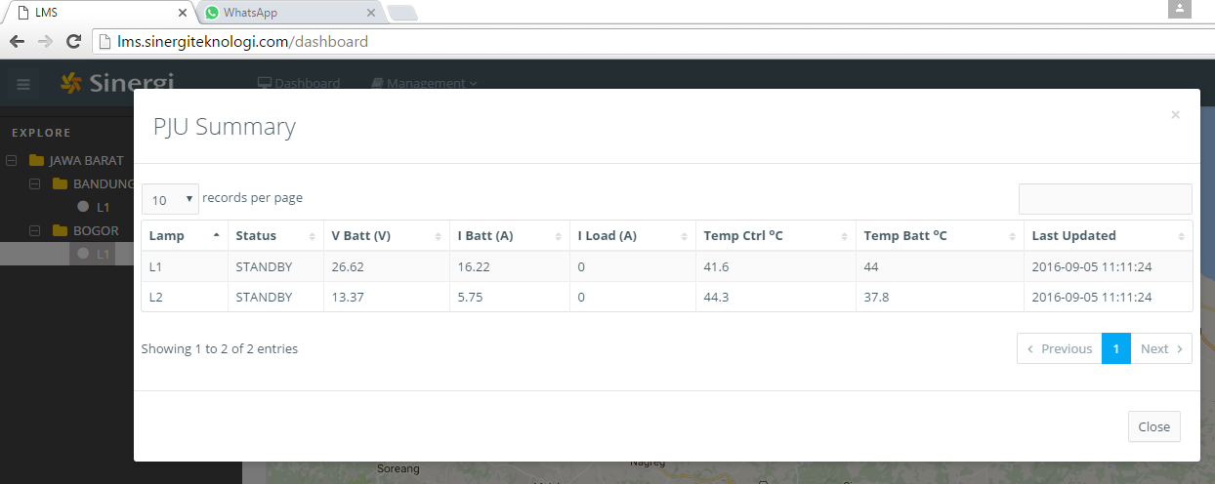
Status all PJU Bogor

Slide 8
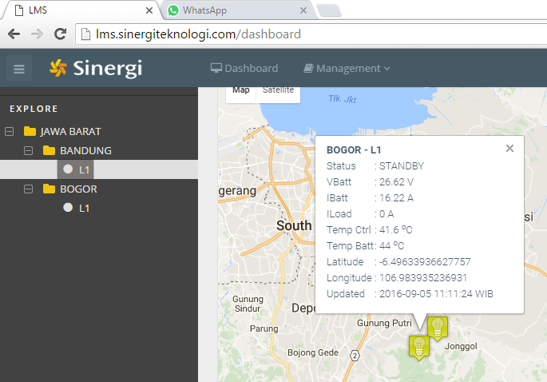
Status PJU Bogor L1

Slide 9
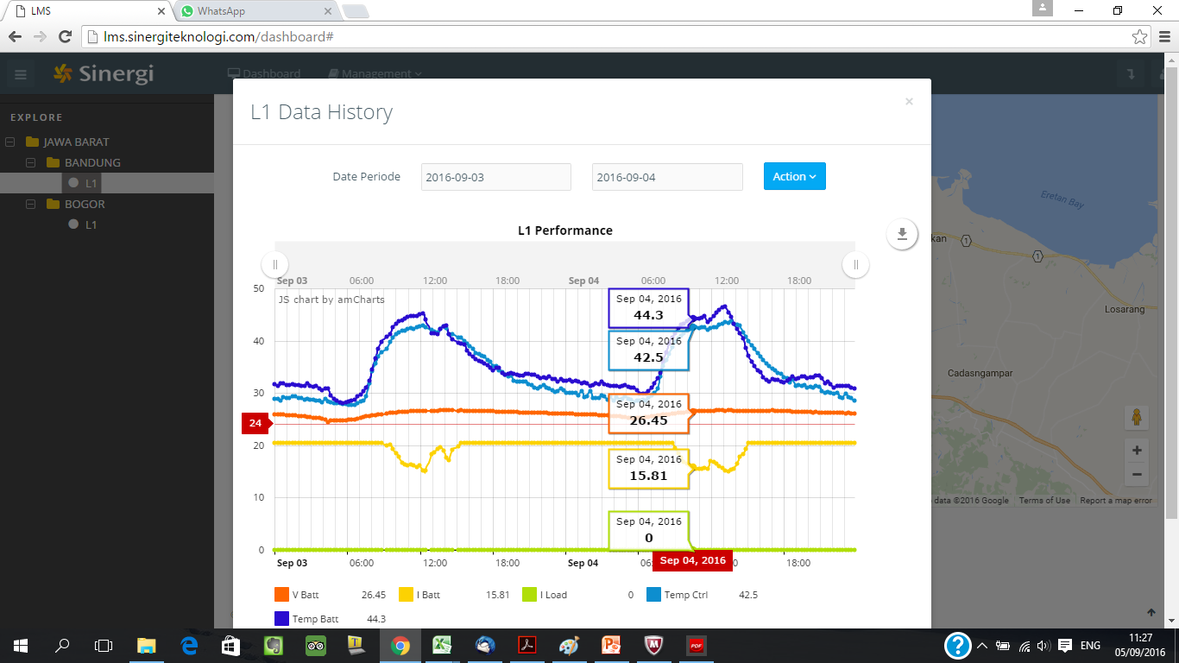
View Chart Datalog Bogor L1

Slide 10
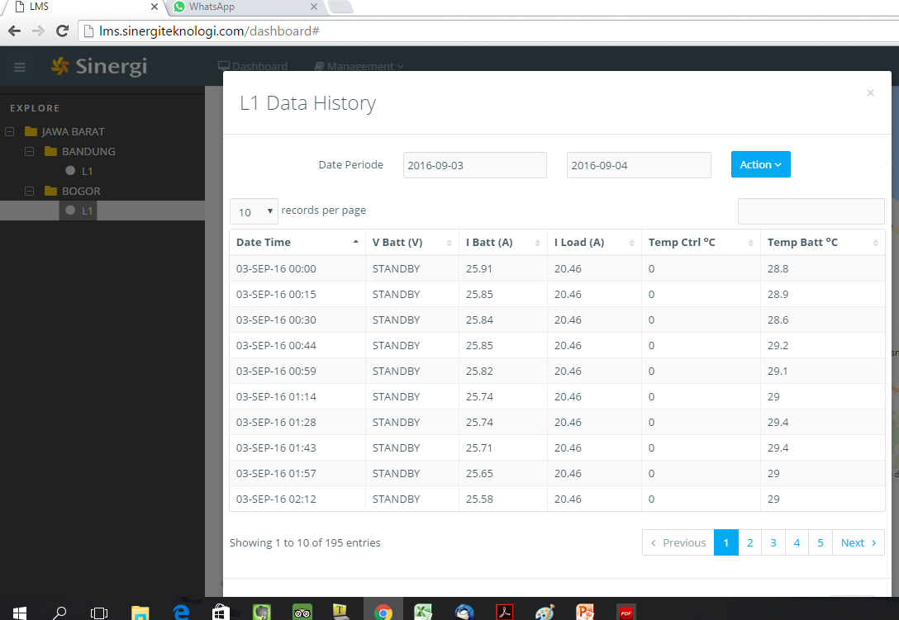
View Tabel Datalog Bogor L1

Slide 11
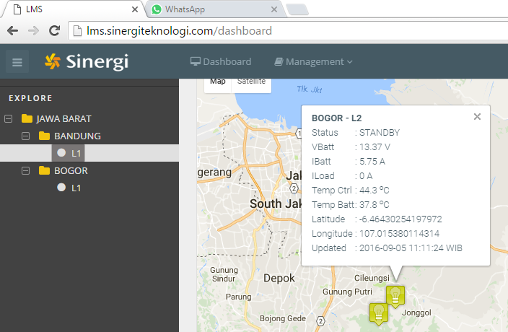
Status PJU Bogor L2

Slide 12
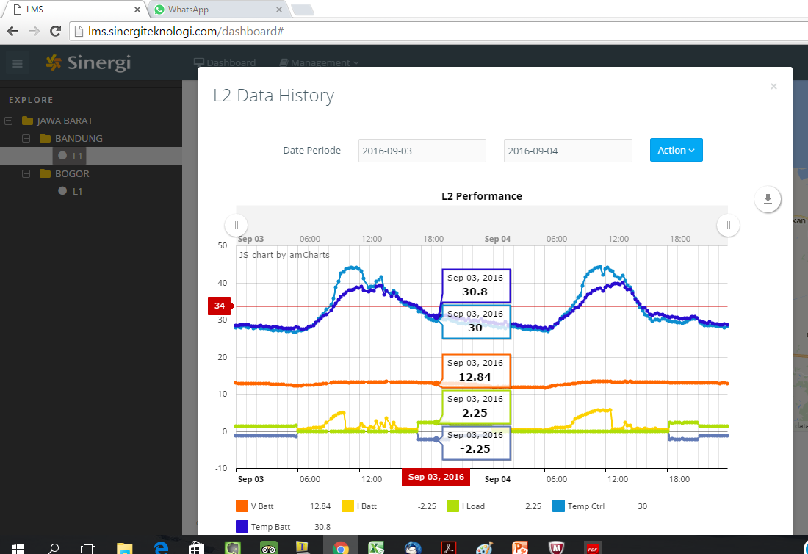
View Chart Datalog Bogor L2

Slide 13

View Tabel Datalog Bogor L2

Slide 14
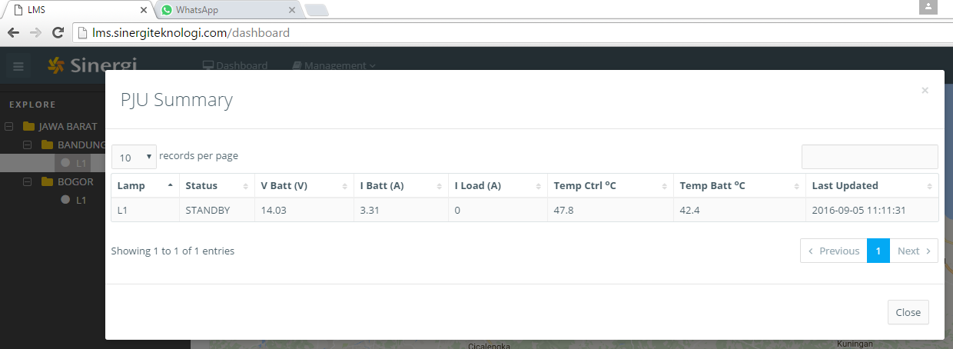
Status All PJU Bandung

Slide 15
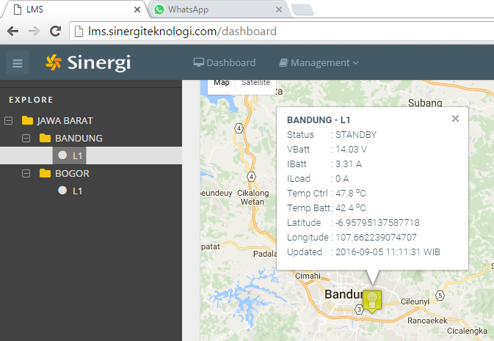
Status PJU Bandung L1

Slide 16
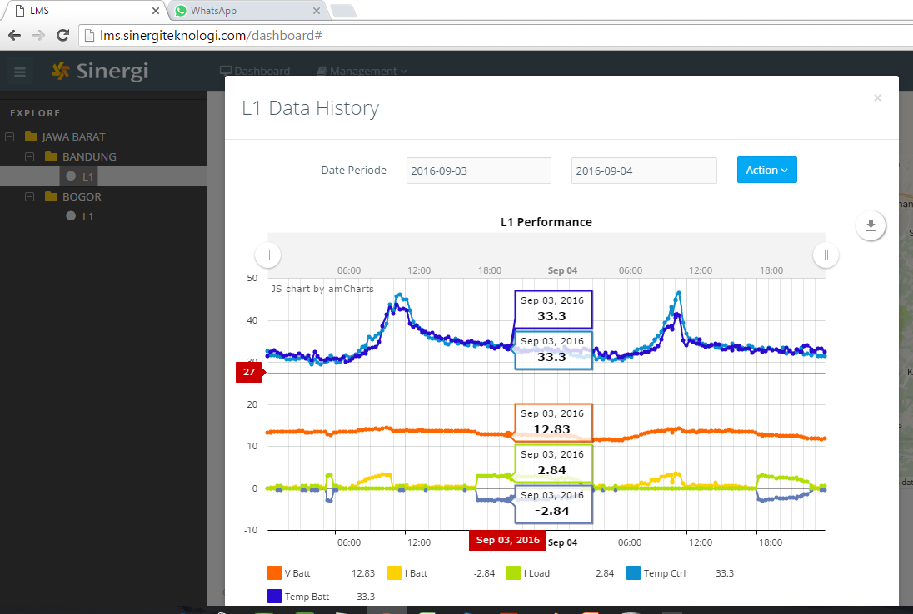
View Chart Datalog Bandung L1

Slide 17
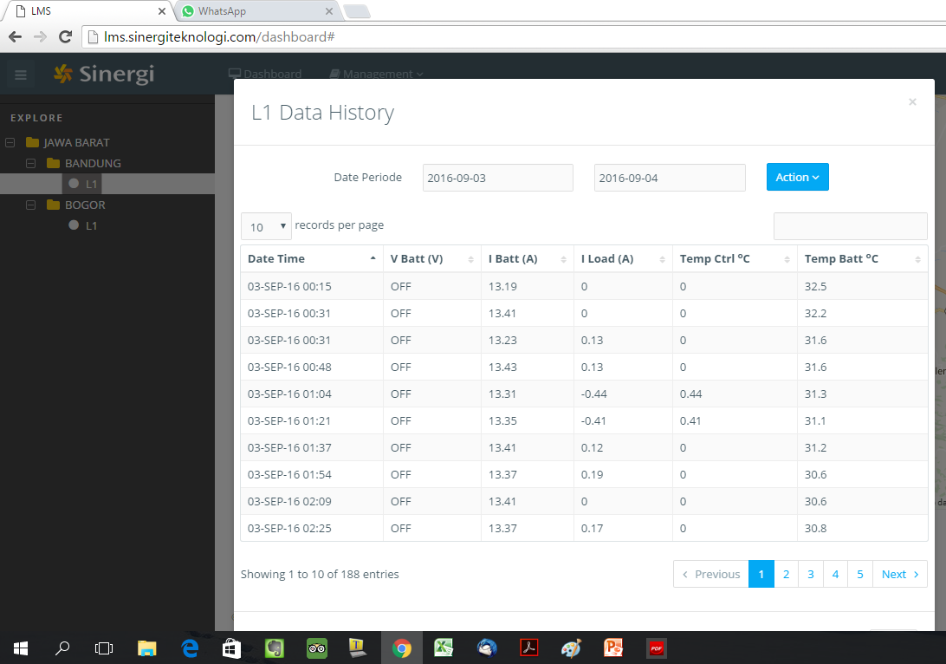
View Tabel Datalog Bandung L1

